Slide 1
BIO-MEDICAL WASTE MANAGEMENT
BY
Kavana Kaveramma B B
Isha Ganapathy
M Sai Sneha Latha Reddy
Vandana B M

Slide 2
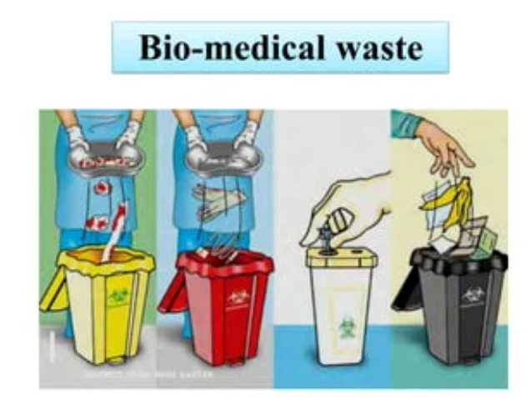
Definition: Bio Medical Waste (BMW) is any waste generated during medical diagnosis, treatment, or immunization involving humans or animals.
Examples: Used syringes, bandages, blood bags, anatomical waste, expired medicines, cultures, laboratory waste.
Dangers of improper BMW disposal:
Infection: Improperly disposed needles and other sharps can transmit diseases like HIV and hepatitis.
Environmental contamination: Improper disposal can lead to soil and water pollution, harming ecosystems and human health.
Spread of antibiotic resistance: Improper disposal of antibiotics can contribute to the development of antibiotic-resistant bacteria.

Slide 3
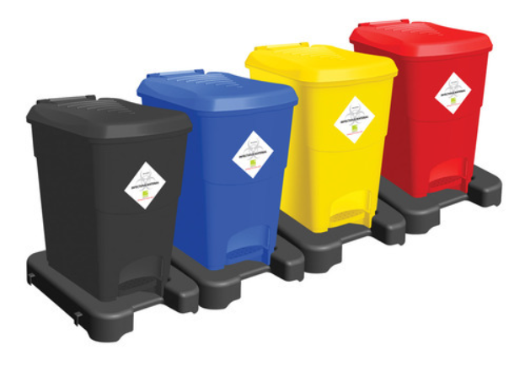
Categories of Segregation
Categories based on risk level:
Category 1 (red): Infectious waste (high risk) - Used syringes, bandages, blood bags.
Category 2 (yellow): Non-infectious waste (moderate risk) - Dressings, soiled linen, disposable gloves.
Category 3 (black): Sharps (high risk) - Needles, scalpels, blades.
Category 4 (blue): Cytotoxic waste (hazardous) - Chemotherapy drugs, waste from cancer treatment.
Category 5 (brown): Pharmaceutical waste (hazardous) - Expired or unused medications.
Importance of proper segregation and handling for each category: Ensures safe disposal and minimizes risks.

Slide 4
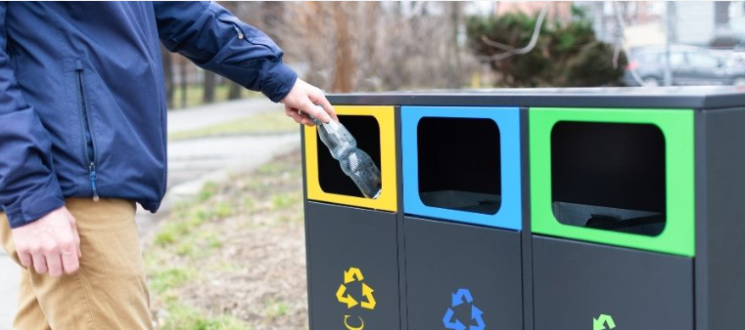
Things to bear in mind
Segregation at the source:
Use color-coded bins with clear labels for each category.
Train healthcare workers on proper segregation procedures.
Safe storage:
Secure containers with lids to prevent spillage and leaks.
Temperature control for specific waste types (e.g., refrigerated for infectious waste).
Transportation:
Use leak-proof containers and licensed transporters for safe movement.
Treatment and disposal:
Incineration for infectious and cytotoxic waste.
Autoclaving for some infectious waste.
Landfilling for non-infectious waste (with proper precautions).
Personal protective equipment (PPE):
Wear gloves, masks, and other protective gear when handling BMW to minimize exposure risks.

Slide 5

Advantages of Bio Waste Management
Protects public health: Reduces risk of infections and environmental contamination, promoting overall health and well-being.
Protects healthcare workers: Minimizes occupational hazards and ensures a safe working environment.
Protects the environment: Proper disposal prevents soil, water, and air pollution, safeguarding ecosystems and natural resources.
Promotes sustainability: Reduces reliance on landfills and promotes responsible waste management practices.

Slide 6
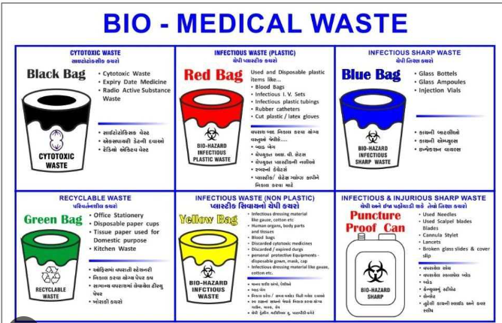
Conclusion
Bio medical waste management is crucial for protecting health, the environment, and our communities.
We all have a role to play:
Healthcare facilities: Implement and enforce proper BMW management practices.
Individuals: Be mindful of medication disposal and support responsible waste management initiatives.
Together, we can create a healthier and more sustainable future.

Slide 7
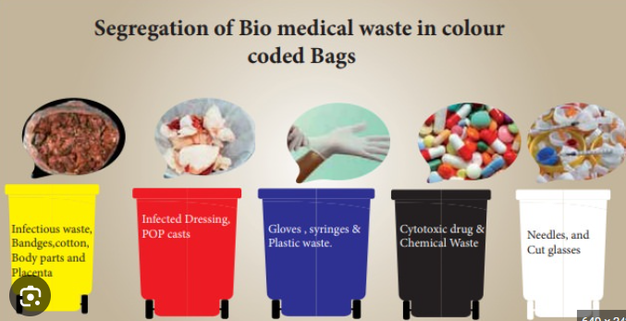
THANK YOU

